Slide 1


Vegetable
Gardening
Plant Selection and Care
By
Ron Kujawski

Slide 2
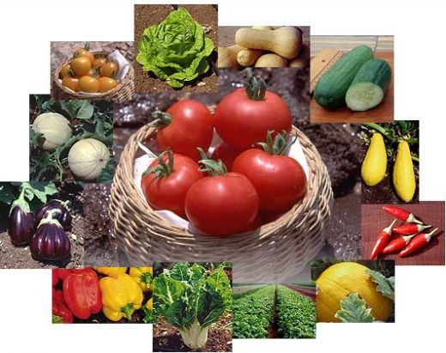
Plant what you’ll eat

Slide 3
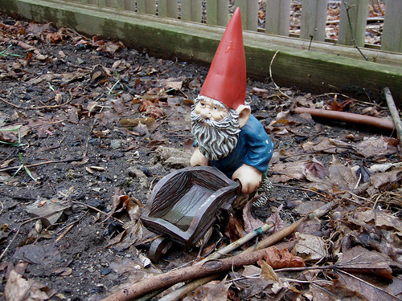
Think Small

Slide 4
Select Crops Carefully!
Crops for a small garden:
Space efficient crops: tomatoes, leaf lettuce,
summer squash, peas, beans, beets, carrots,
cucumbers, pole beans
Bush varieties: cukes, squash, melons
Short season crops: radish, greens
Long yields: tomatoes, peppers, pole beans

Slide 5
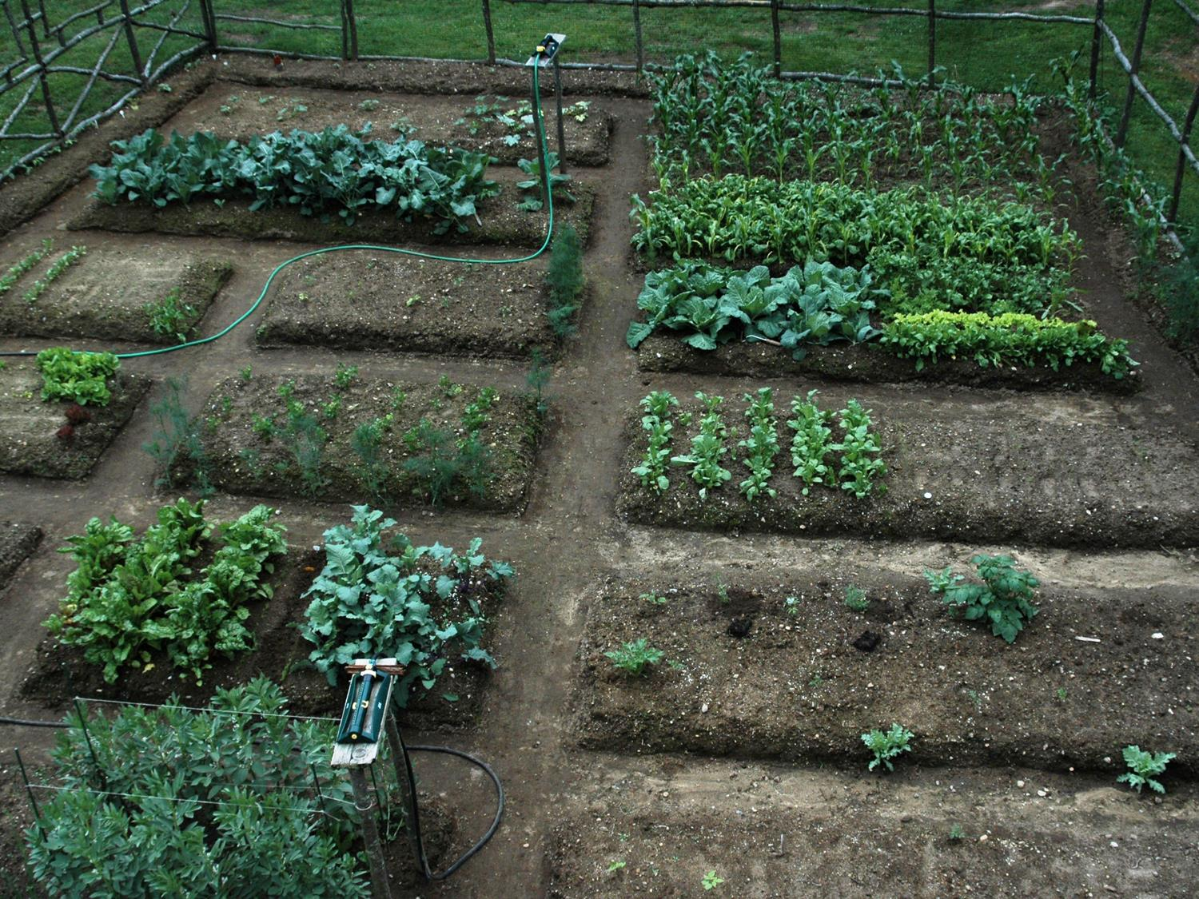
Keep rows short at first

Slide 6
Starting the season:
Select cold hardy and cold tolerant plants
Require cold: Arugula, celery, lettuce, onion, pea, radish, spinach, other greens
Tolerate cold: Root crops, cole crops, collards, potato

Slide 7

Become a weather watcher!

Slide 8

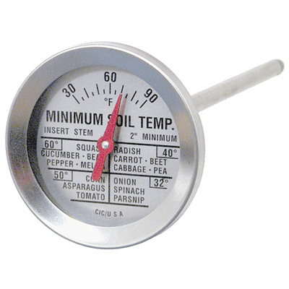
Monitor
Soil Temperatures:

Slide 9
Select cold hardy and cold tolerant plants
Germinate @ 35 F: lettuce, onion, parsnip, spinach, other greens
@ 40 F: Root crops, cole crops, celery, chard, peas
@ 50 F: Warm season crops

Slide 10






Warm Season Crops
After danger of frost, warm soil
Fruiting crops, vines, beans
Transplants vs. seeding

Slide 11
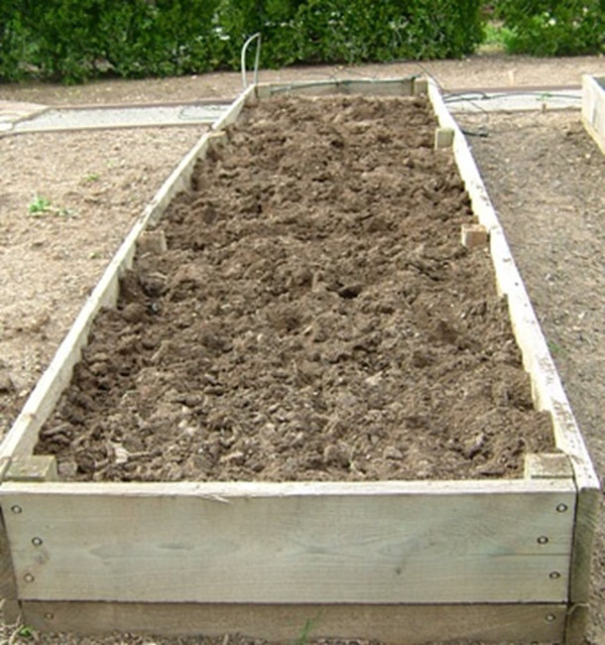
Getting an Early Start
Raised beds for earliest start

Slide 12
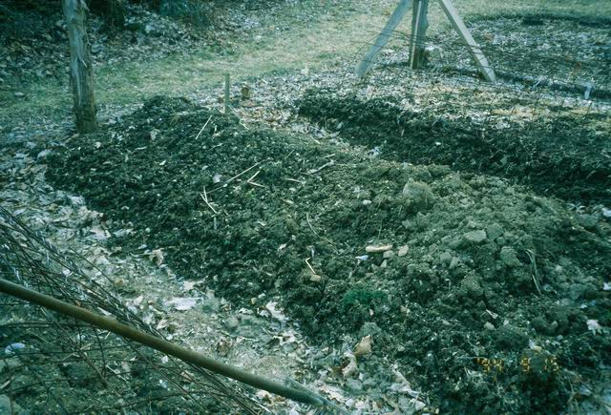
Prepare raised beds in fall
Raised beds raise T =/> 5°F

Slide 13
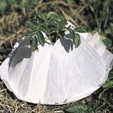
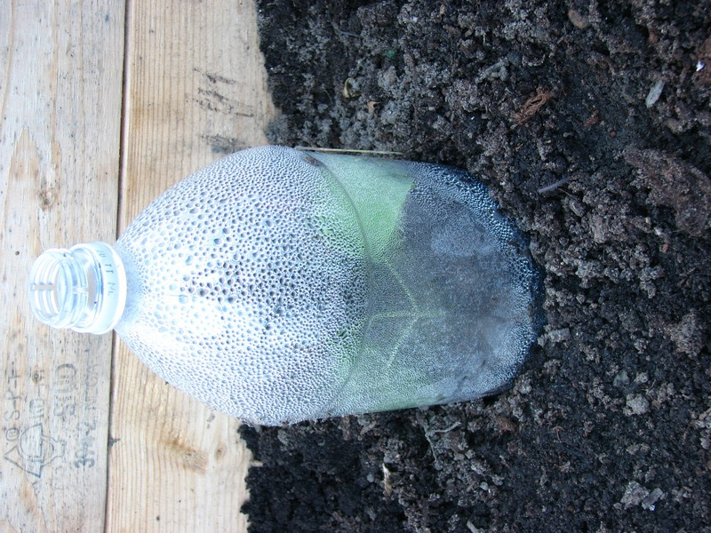
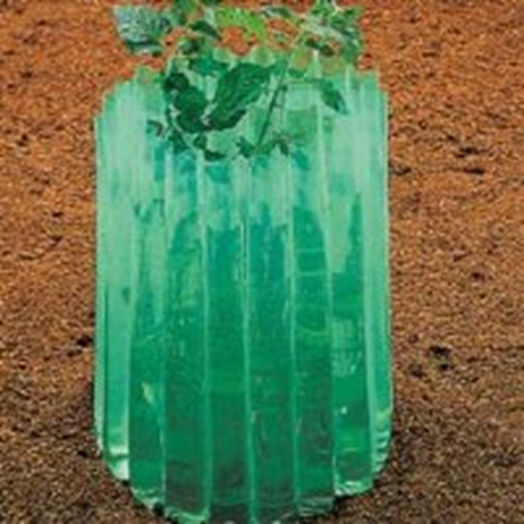
Use cold protection devices:
Hot Caps

Slide 14
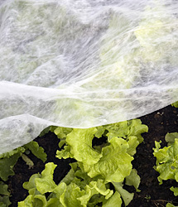
Fabrics
Protects to 28 F
Allows light, air & H2O
Floats above plants
Insect protection
May last 2-3 years

Slide 15
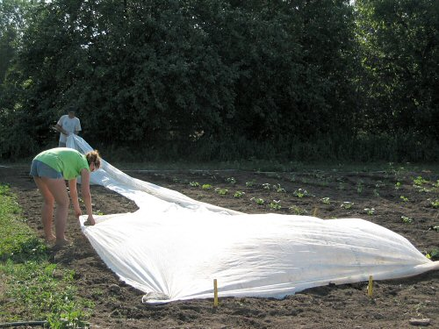
Fabrics

Slide 16
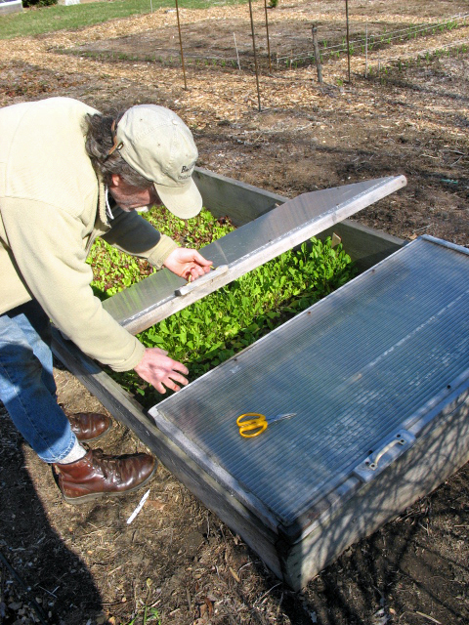
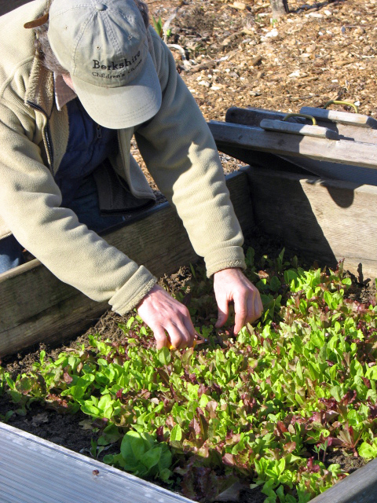
Cold Frames

Slide 17
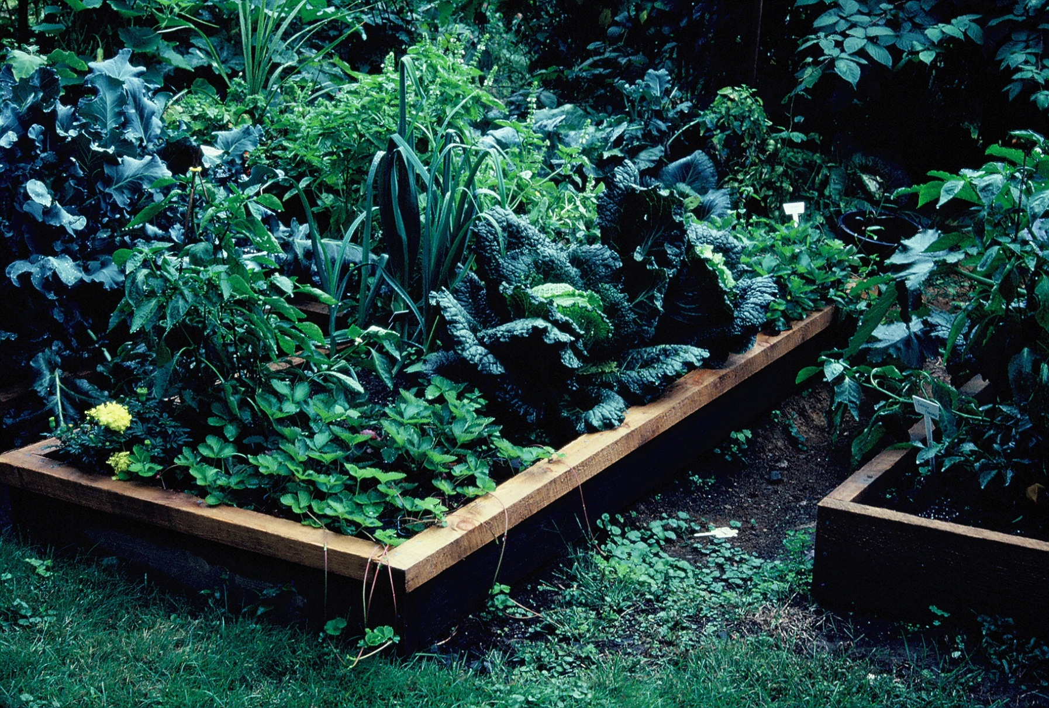
Use All of Your Space All Season

Slide 18
Use plant succession
Multiple cropping of one vegetable with short growing season: radish, greens

Slide 19
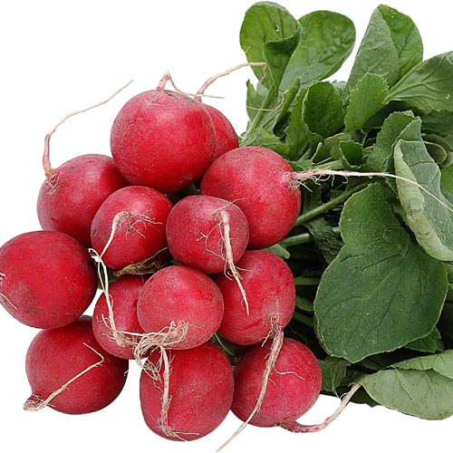
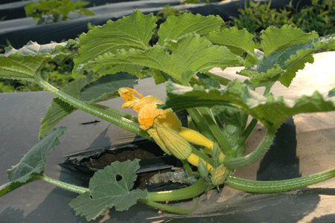
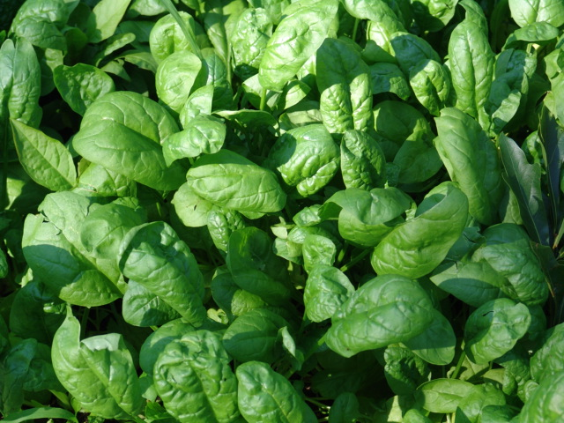
Sequencing:
Early
Mid-season
Late

Slide 20
Use Intercropping
Fast growers among slow growers
Radishes and carrots
Alternate rows of fast grower and slow grower
Lettuce and tomatoes

Slide 21
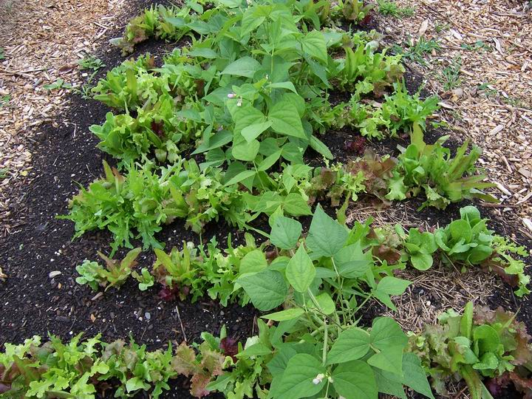
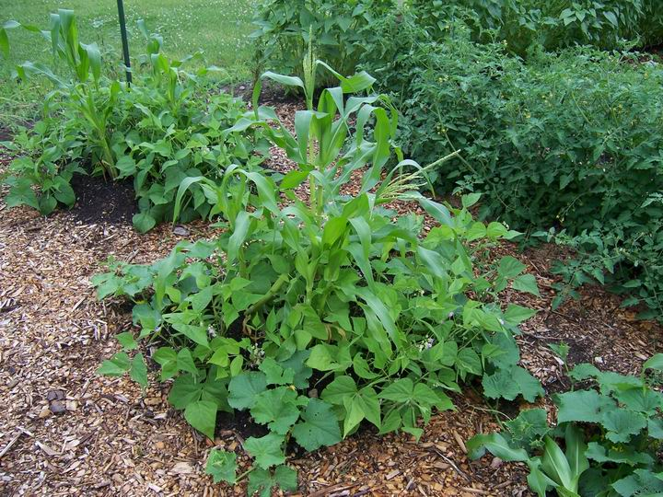
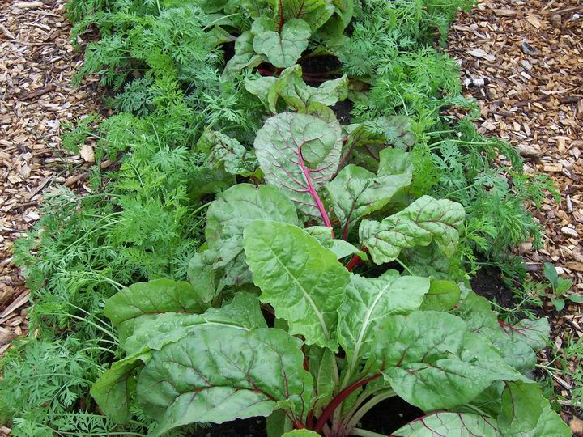

Slide 22
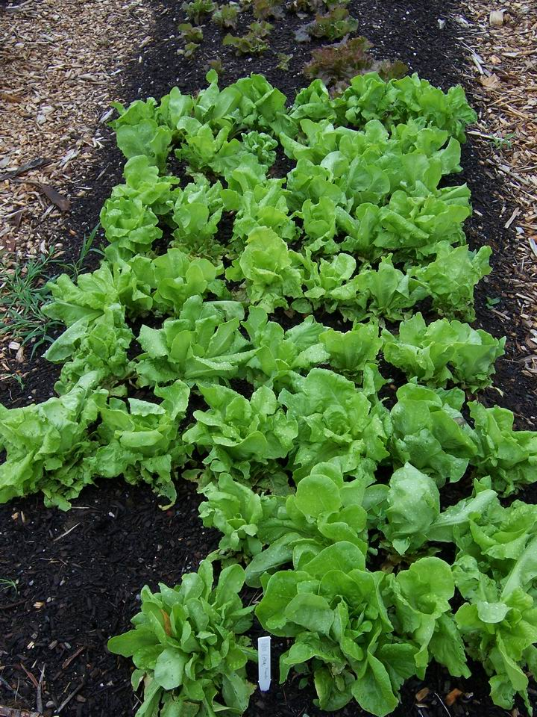
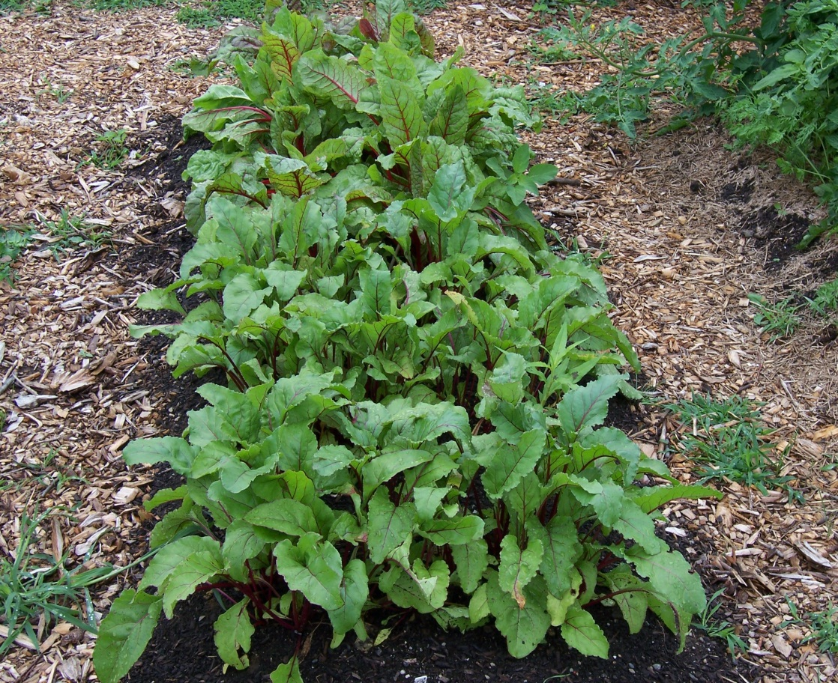
Wide Row Methods
Scatter seeds 12-18” for
leafy greens, root crops

Slide 23
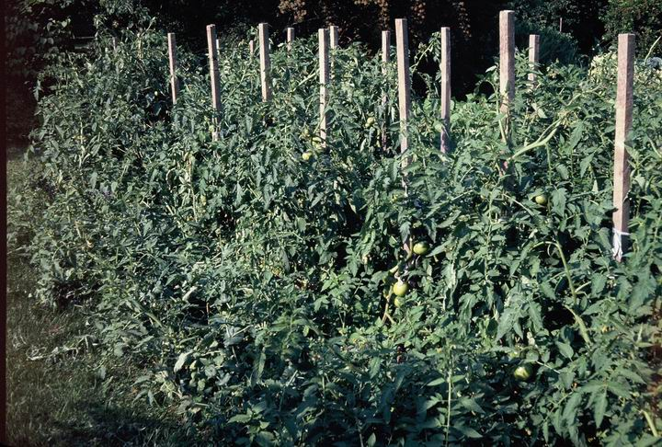
Vertical Space – The 3rd Dimension

Slide 24
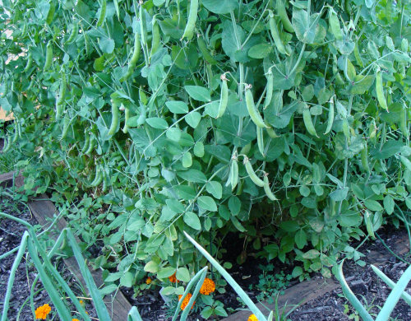
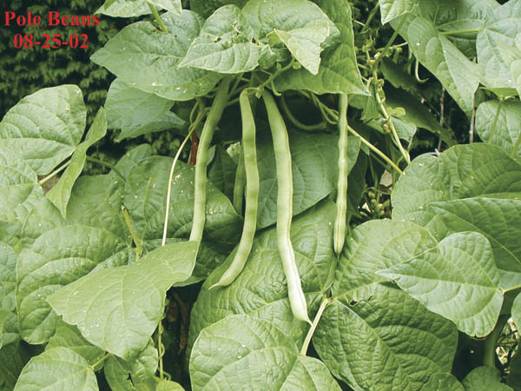
Take advantage of natural climbers
Pole Beans
Peas

Slide 25
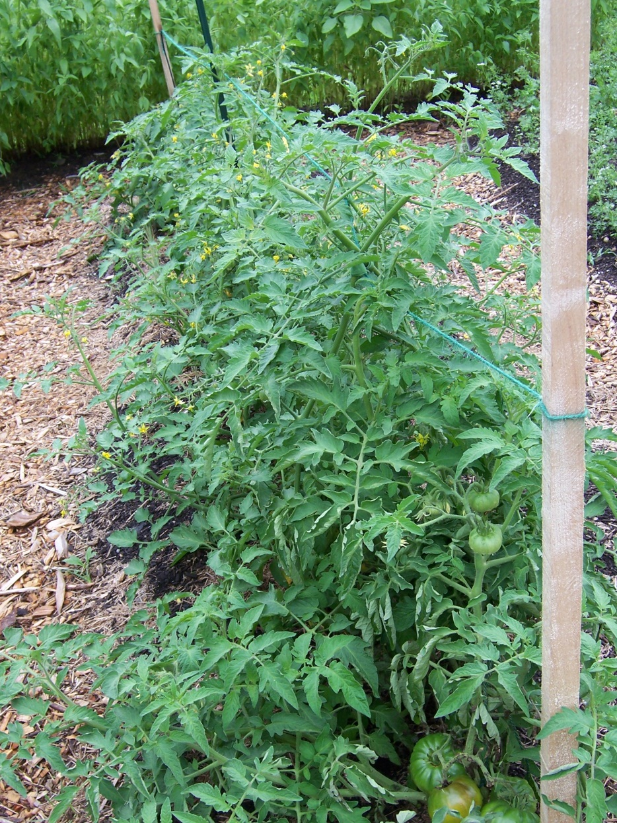
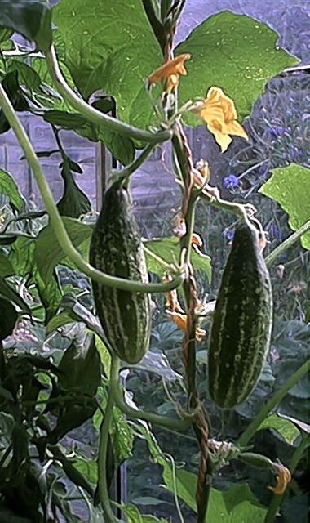
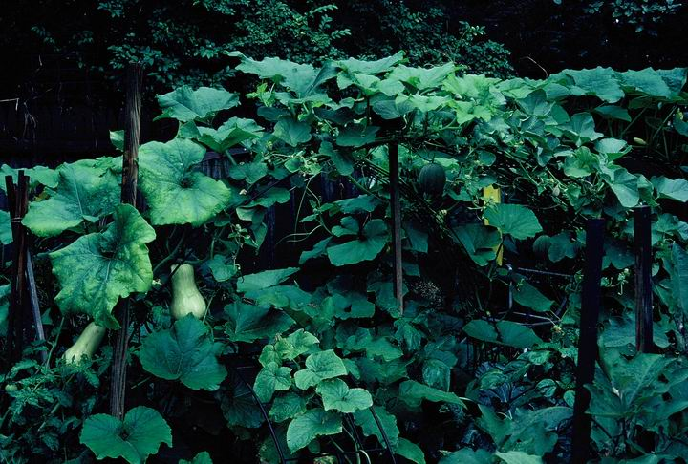
Train non-climbing vine crops
Cucumbers
Tomatoes
Winter squash/melons

Slide 26
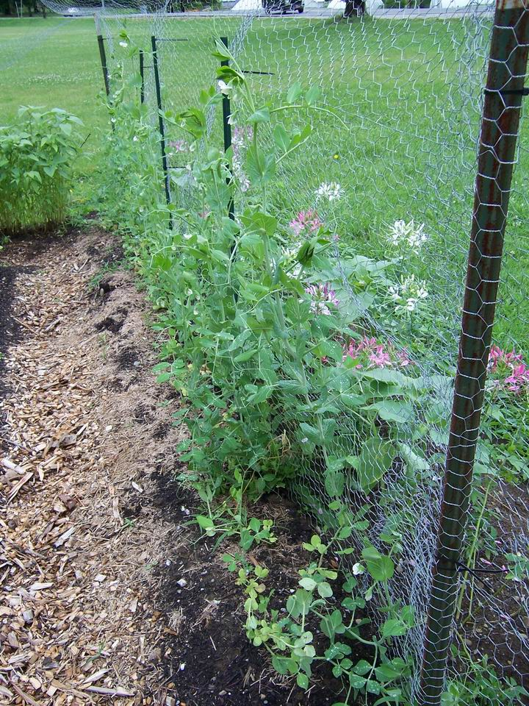
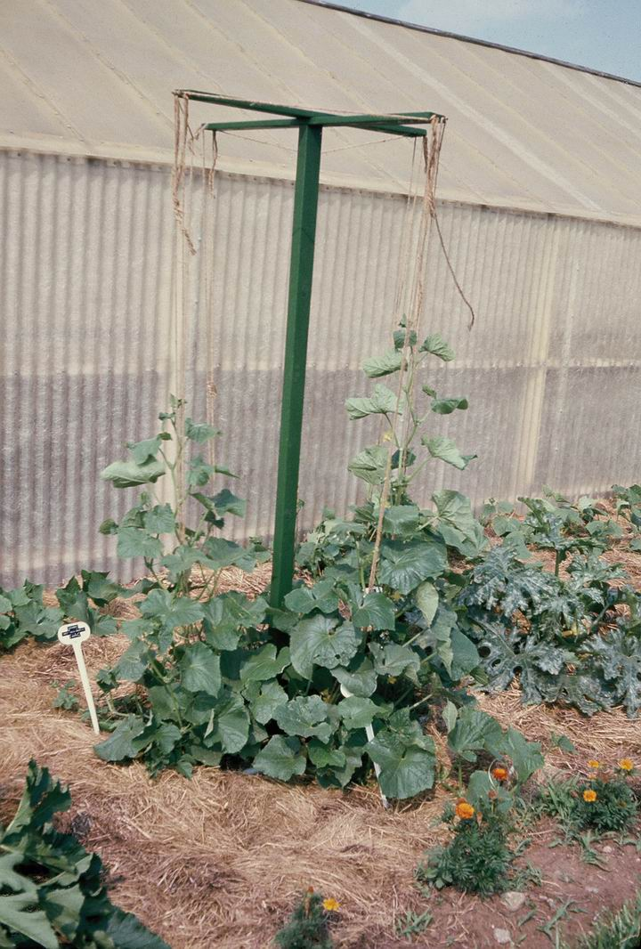
Vertical Structures
Fences
Poles

Slide 27
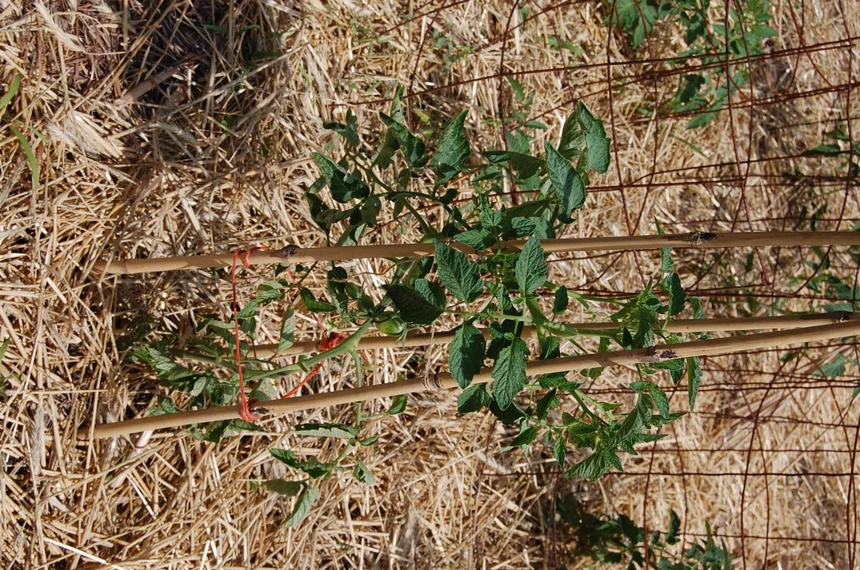
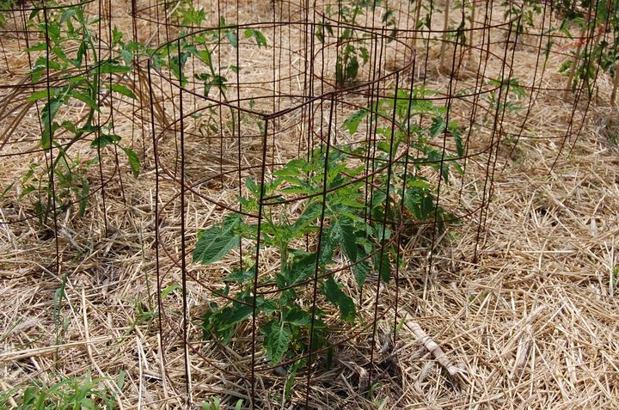
Cages
Cages

Slide 28
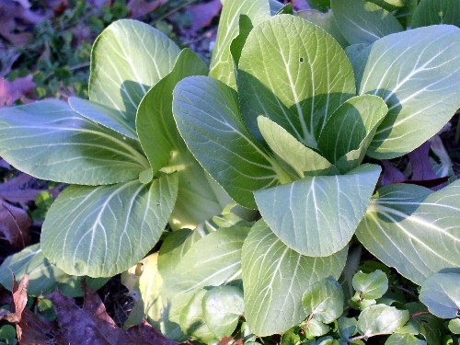
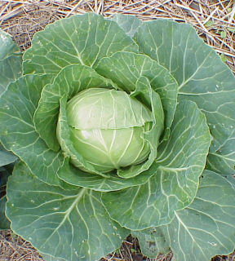
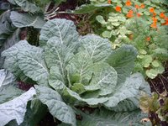
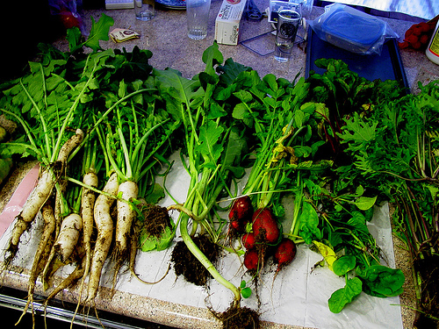
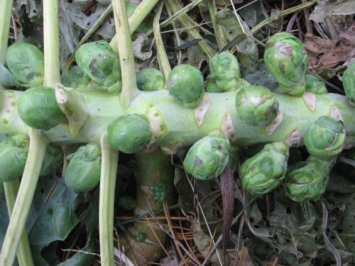
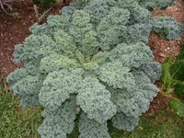
Plan for fall garden

Slide 29
Crops for fall gardens
Any crops which can be planted in early spring.
Brassicas
Greens
Root crops
Leeks and green onions
Peas (Wando)

Slide 30
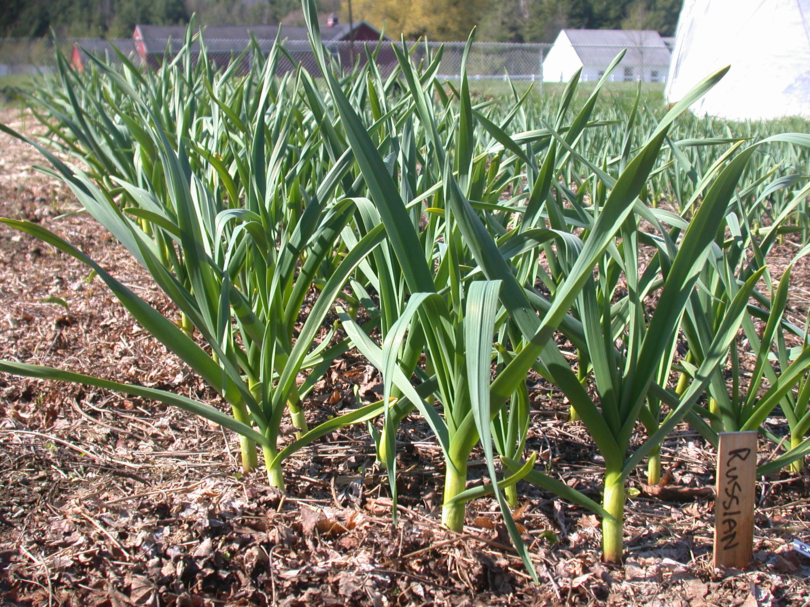
Keep up with maintenance
Weed control – shallow cultivation

Slide 31
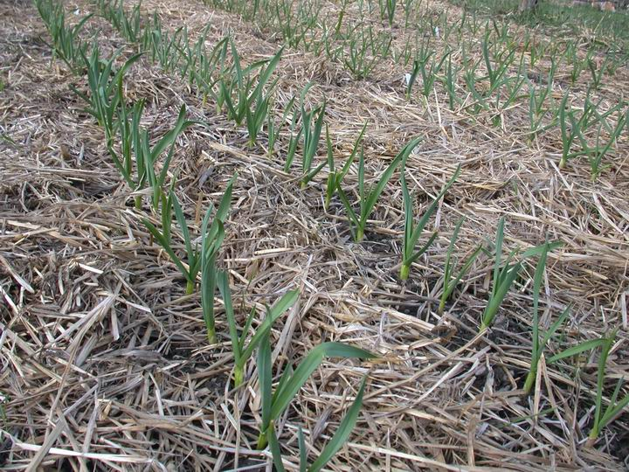
Mulch

Slide 32

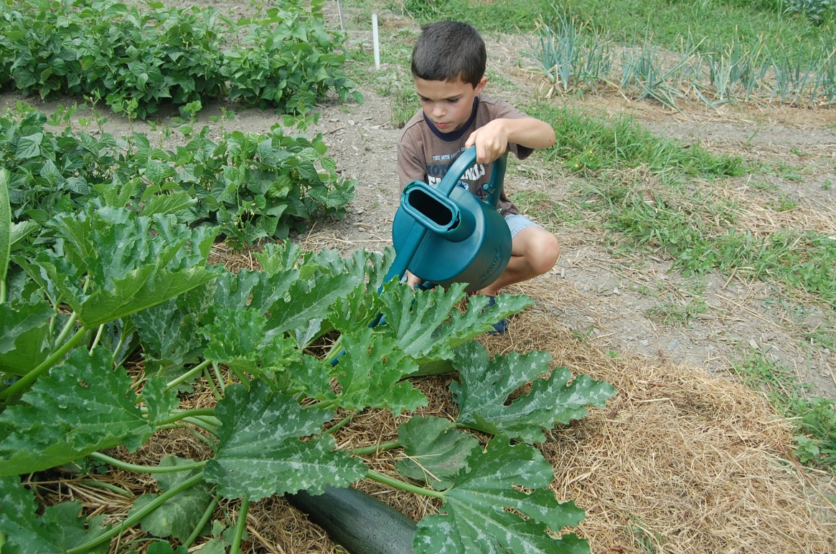
1 inch per week or supplement

Slide 33
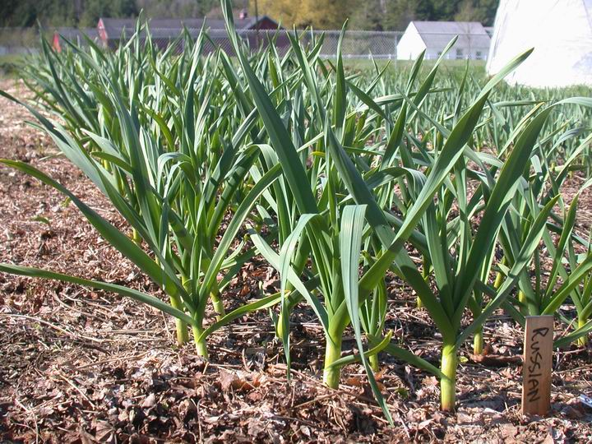
Sidedress: Hi N

Slide 34

Develop Strategy
For Managing Garden Pests

Slide 35

Step 1: Monitoring
Check plants often
Look for abnormal growth
Check undersides of foliage
Evaluate vigor
Know what is normal
Use monitoring tools

Slide 36

Step 2: Indentification
Identify plant, pest or disease
Reference books
Plant name
Some are beneficial
Proper control/timing

Slide 37
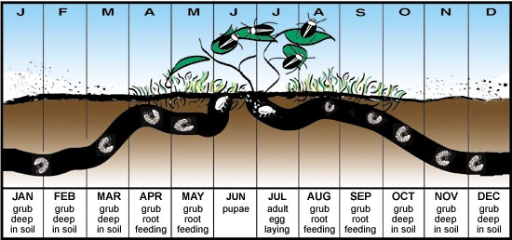
Step 3: Learn Pest’s Life Cycle

Slide 38
Step 4: Select the Control Option
Cultural
Mechanical
Bio-rational

Slide 39
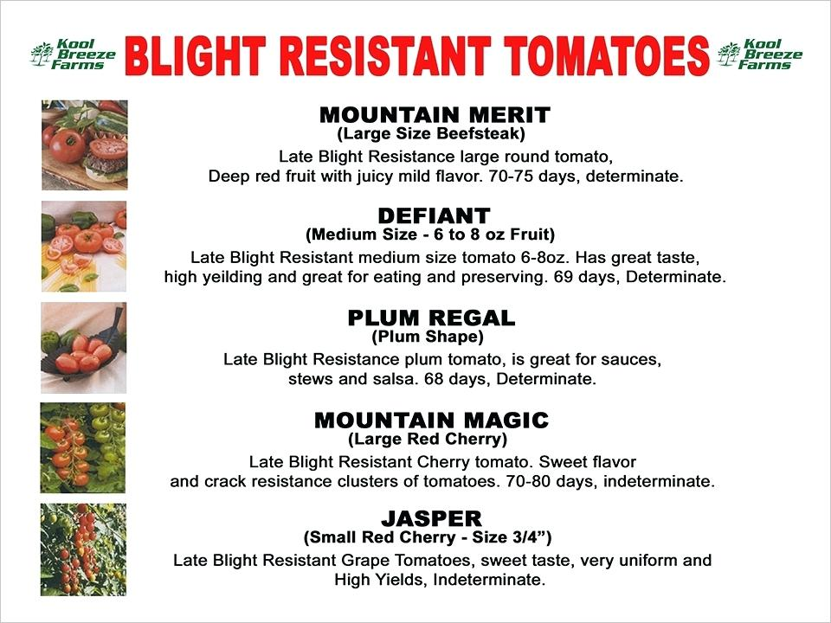
1.Cultural
Resistant Varieties

Slide 40
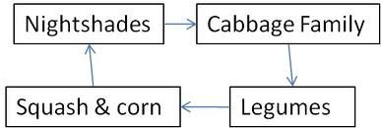
Cultural:Crop Rotation

Slide 41
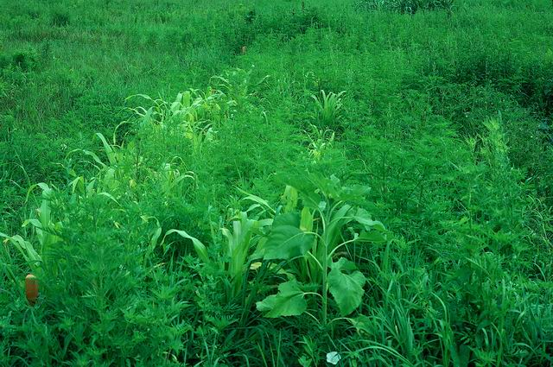
Promote Plant Vigor
Fertilize
Timely watering
Weed management

Slide 42
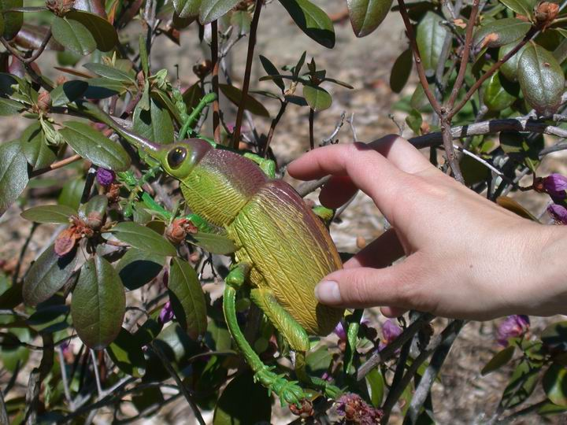
2. Mechanical
Hand
picking

Slide 43
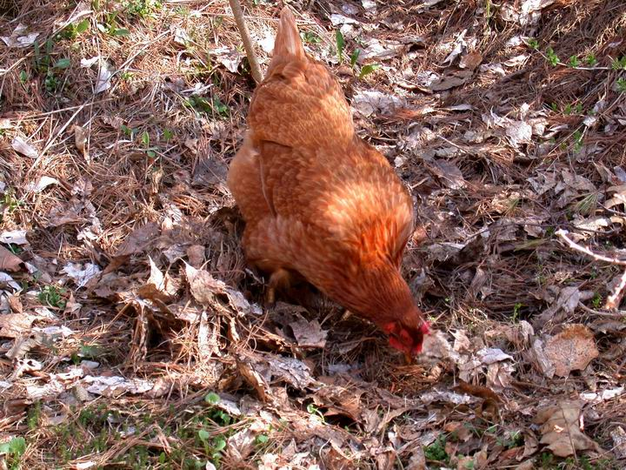
Mechanical
Hen pecking

Slide 44
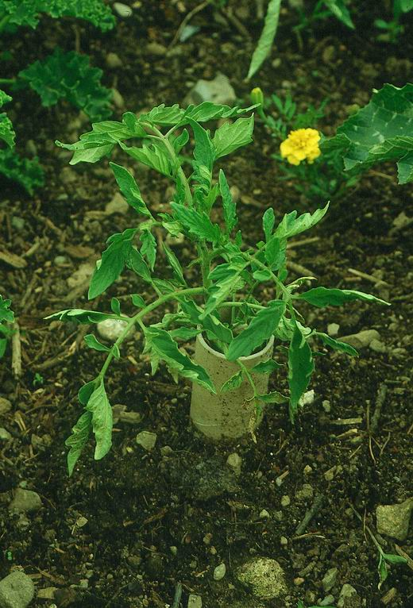
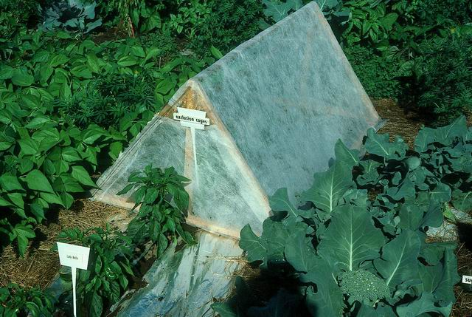
Mechanical
Exclusion:Barriers

Slide 45





Use Bio-Rational Pesticides

Slide 46
Examples of
Bio-Rational Pesticides
Mechanical:
  Insecticidal Soap and Horticultural Oils
Minerals: diatomaceous earth, sulfur
Microbials B.t. (Dipel), B. subtilis (Serenade), Spinosad
Botanicals: (NEEM)

Slide 47
Determine most suitable method
Do nothing

Slide 48

Keep Records

Slide 49


